Slide 1
SLACK QUERIES ANALYSIS

Slide 2
WHAT I HAVE DONE IN PROJECT
ANALYSIS ON SLACK QUERIES DATASET ON BELOW OBJECTIVES

Slide 3
OBJECTIVES:-
Check the Datatypes and convert relevant columns to Date and Time format.
Fill Missing Values with Appropriate Method.
How many Students and Work Professionals are raising queries ?
What is the Average time taken to respond to a query?
Which are the top 10 queries that took longest time to resolve ?
Which Phase of Project is having highest Queries?
Which project phase queries are taking a long time to resolve?
On which day highest queries were resolved?
Which phase queries are easier to resolve?
Conclusion Of Analysis.

Slide 4
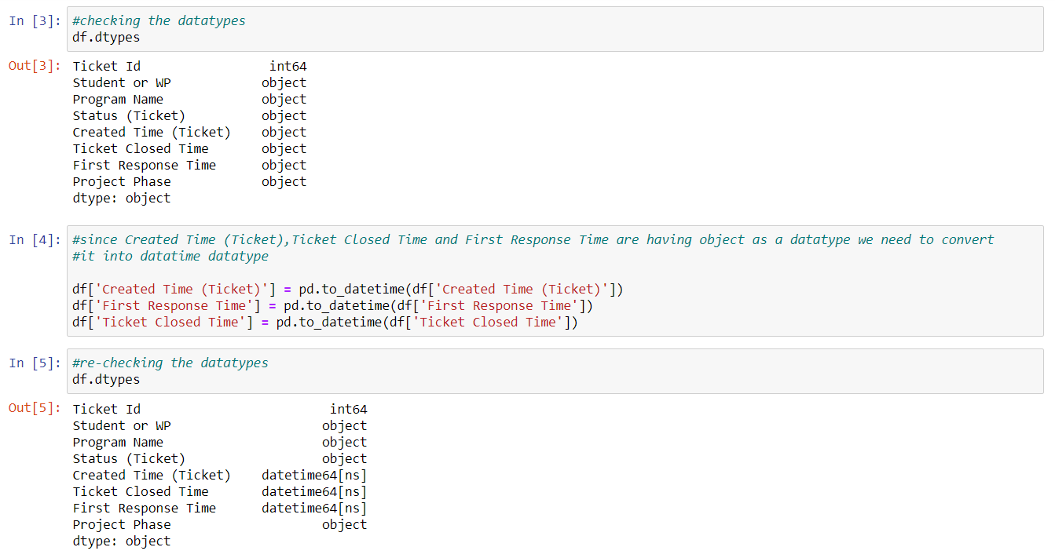
1. Check the Datatypes and convert relevant columns to Date and Time format.

Slide 5
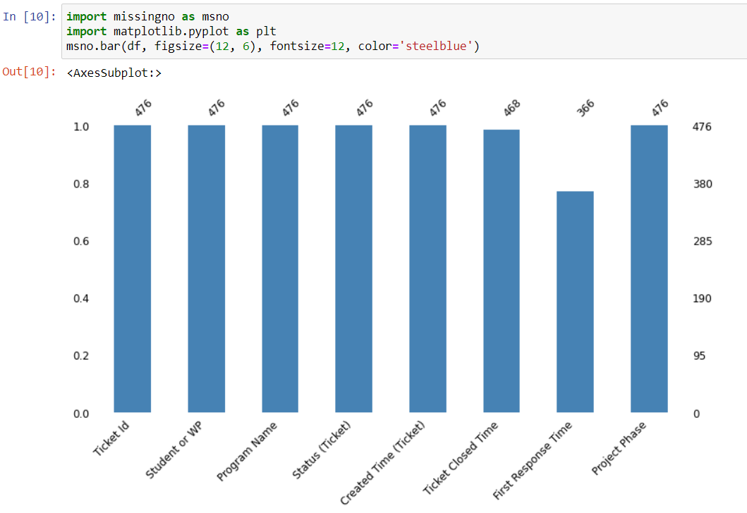
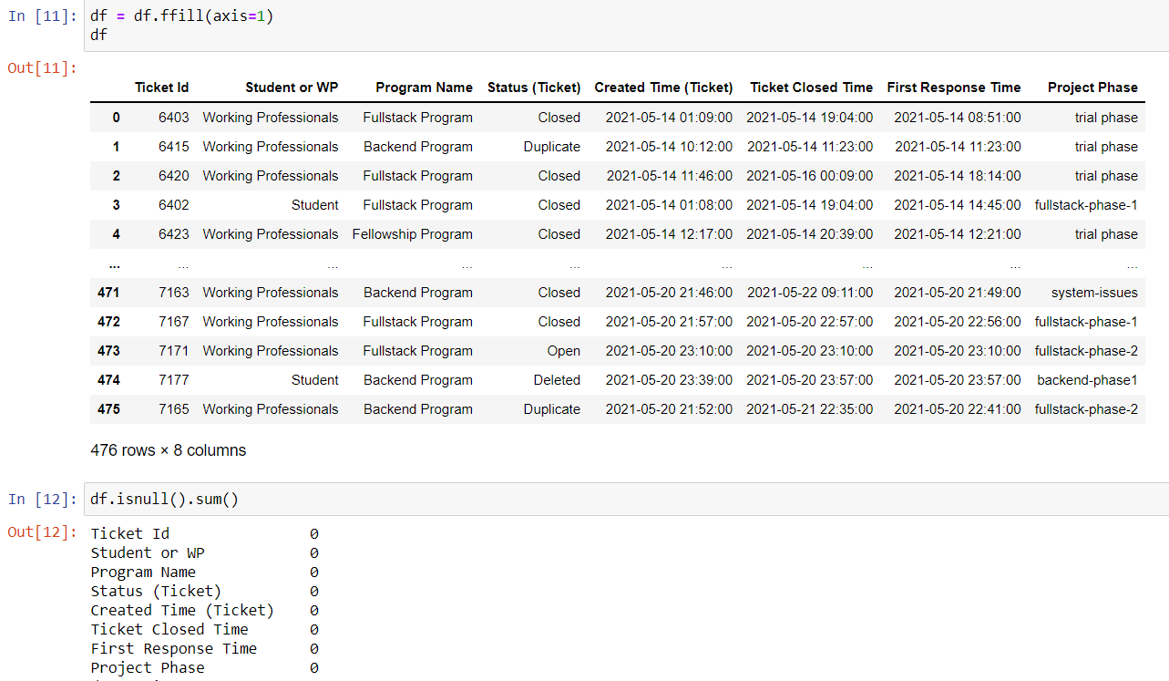
2. Fill Missing Values with Appropriate Method. From the below graph, in ticket closed time there are 8 missing value and in first response time there are 110 missing value, handled them by using ffill(forward fill) function

Slide 6
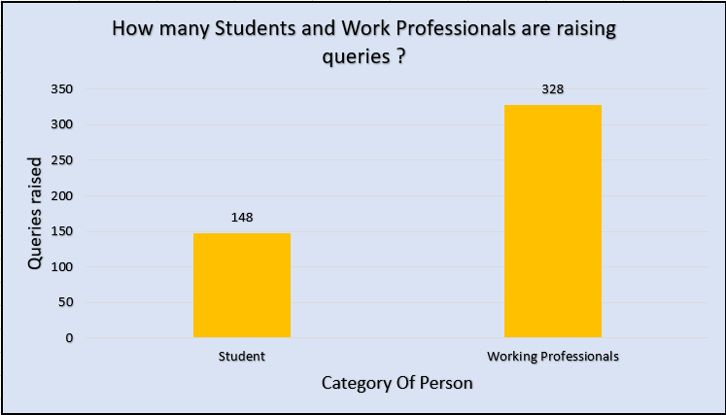
3. How many Students and Work Professionals are raising queries ?
We can infer that there are 328 working professional and 148 students who are raising the queries

Slide 7
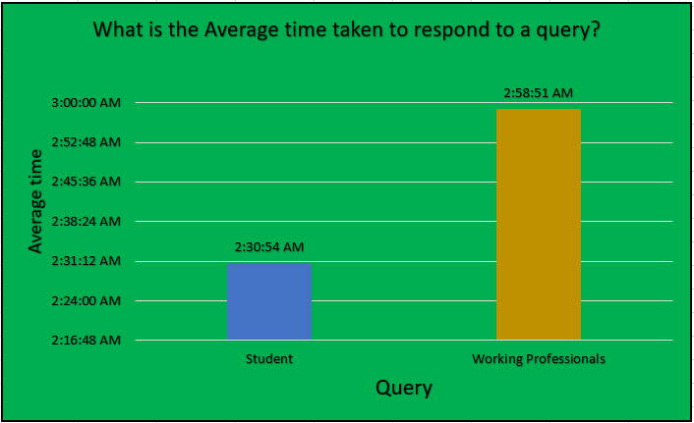
4. What is the Average time taken to respond to a query?
Average time taken to respond to working professionals queries is more as compared to student queries

Slide 8
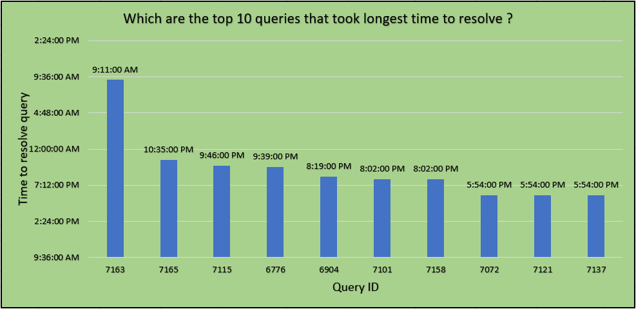
5. Which are the top 10 queries that took longest time to resolve ?
Top 10 query id that took longest time to resolve

Slide 9
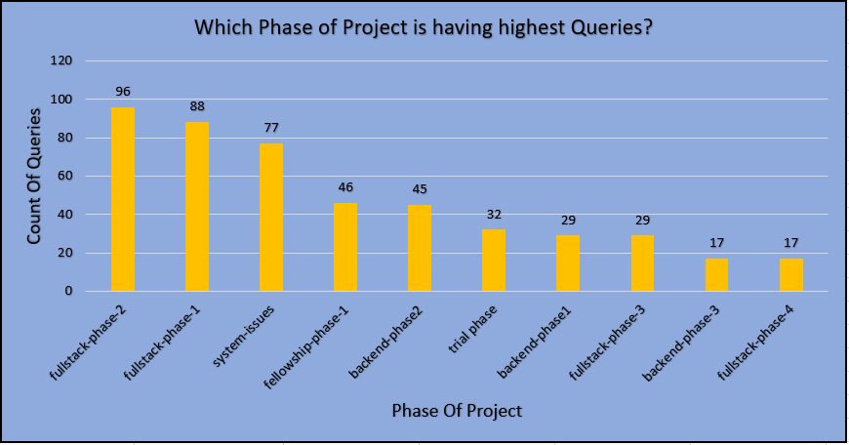
6. Which Phase of Project is having highest Queries?
Fullstack-phase-2 is having highest queries as compared to other phases of project

Slide 10
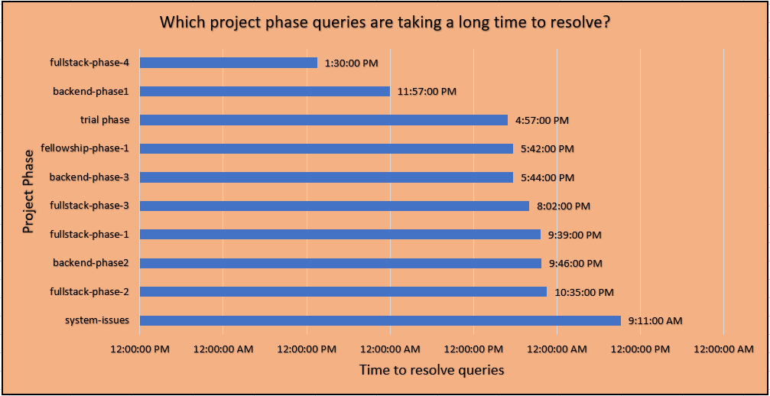
7. Which project phase queries are taking a long time to resolve?
System-issues is taking a long time for queries to be solved as compared to other project phases

Slide 11
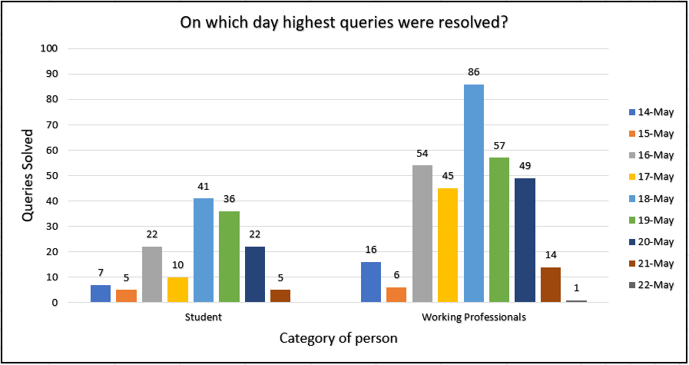
8. On which day highest queries were resolved?
We can see that on 18-May highest queries were resolved for student as well as working professionals

Slide 12
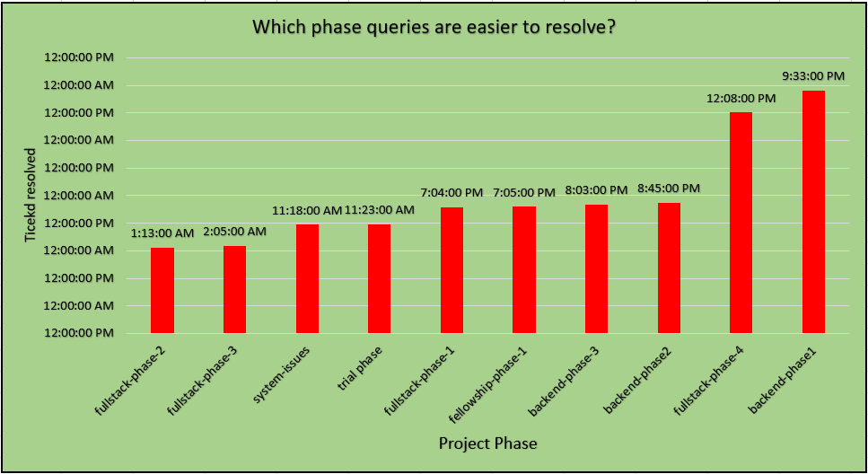
9. Which phase queries are easier to resolve?
Fullstack-phase-2 phase queries are easier as compared to others

Slide 13
Conclusion On Analysis
We have handled the missing values and conversion of relevant datatypes to Date and Time format in python
After successfully cleaning the dataset we export the cleaned dataset and create a visualization insights in Microsoft Excel using Pivots
In that we solved the problem statement and performed basic calculations for visualization and based on which generated meaningful insights

